Slide 1
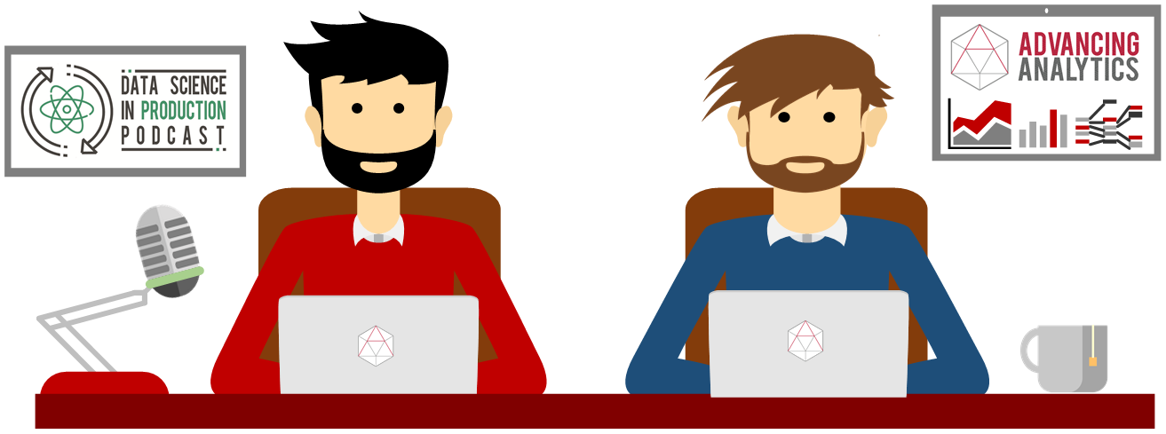
I Ain’t No Data Scientist
Why Do I Need Jupyter Notebooks?

Slide 2
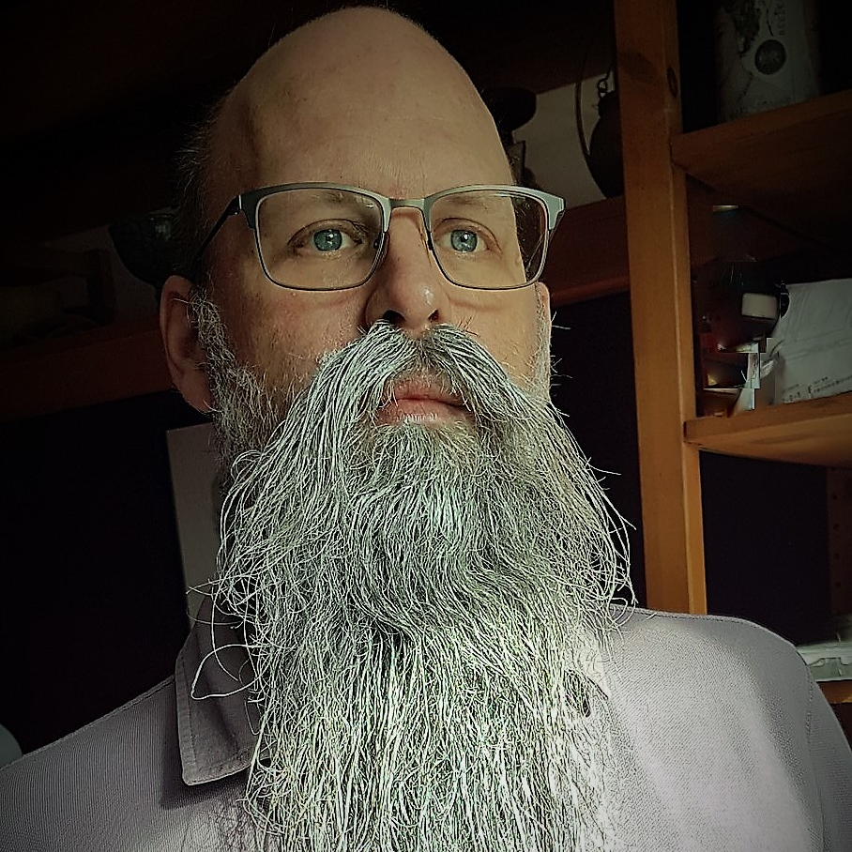
Rob Sewell
Bearded Consultant
Automator
Trainer
Dual MVP
Consultant Sewells Consulting Ltd
dbatoolsMoL dbachecks
ADSNotebooks PowerShell Community
Data Community
beard.media\book
@sqldbawithbeard
blog.robsewell.com

Slide 3
Rob Sewell
Bearded Consultant
Automator
Trainer
Dual MVP
Consultant Sewells Consulting Ltd
dbatoolsMoL dbachecks
ADSNotebooks PowerShell Community
Data Community
beard.media\book
@sqldbawithbeard
blog.robsewell.com
Notes:
OBS:SpeakerCircle

Slide 4
Rob Sewell
Bearded Consultant
Automator
Trainer
Dual MVP
Consultant Sewells Consulting Ltd
dbatoolsMoL dbachecks
ADSNotebooks PowerShell Community
Data Community
beard.media\book
@sqldbawithbeard
blog.robsewell.com
Notes:
OBS:SpeakerCircleandSide

Slide 5
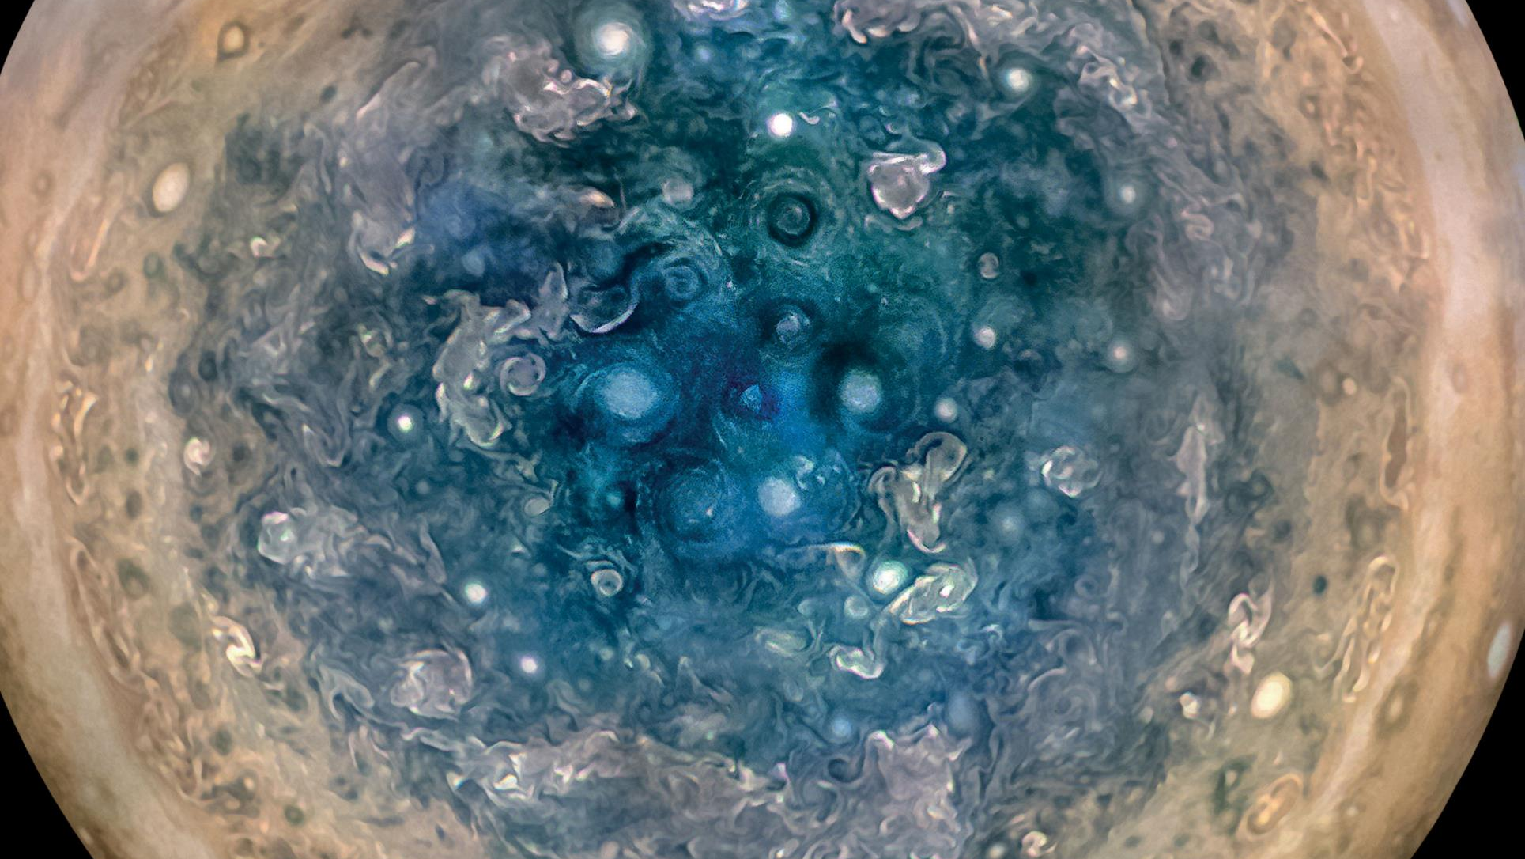

Slide 6
First, the names comes from the planet Jupiter. We wanted to pick a name that evoked the traditions and ideas of science.
Jupyter
Notes:
OBS:SpeakerTopRight

Slide 7
Jupyter
First, the names comes from the planet Jupiter. We wanted to pick a name that evoked the traditions and ideas of science.
Second, the core programming languages supported by Jupyter are Julia, Python and R. While the name Jupyter is not a direct acronym for these languages, it nods its head in those directions. In particular, the "y" in the middle of Jupyter was chosen to honor our Python heritage. See the logos of these languages in the languages folder of this repo.
https://github.com/jupyter/design/wiki/Jupyter-Logo
Notes:
OBS:SpeakerTopRight

Slide 8
Jupyter
Second, the core programming languages
supported by Jupyter are
Julia, Python and R.
While the name Jupyter is not a direct acronym for these languages, it nods its head in those directions.
In particular, the "y" in the middle of Jupyter was chosen to honor our Python heritage.
Third, Galileo was the first person to discover the moons of Jupiter. His publication on the moons of Jupiter is an early example of research that includes the underlying data in the publication. This is one of the core ideas and requirements for scientific reproducibility. Reproducibility is one of the main focuses of our project.
https://github.com/jupyter/design/wiki/Jupyter-Logo
Notes:
OBS:SpeakerTopRight

Slide 9
Jupyter
Third, Galileo was the first person to discover the moons of Jupiter. His publication on the moons of Jupiter is an early example of research that includes the underlying data in the publication.
This is one of the core ideas and requirements for scientific reproducibility. Reproducibility is one of the main focuses of our project.
https://github.com/jupyter/design/wiki/Jupyter-Logo
Notes:
OBS:SpeakerTopRight

Slide 10
So – What IS a Jupyter Notebook?
Originally for Data Scientists
Notes:
OBS:SpeakerTinySquare

Slide 11

First – Lets go back in time

Slide 12
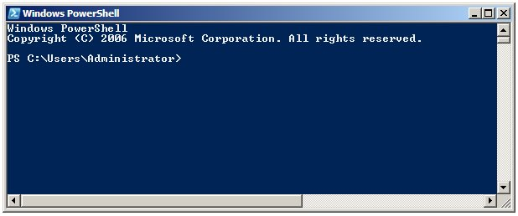
Running PowerShell
2006

Slide 13
Running PowerShell
2006

Slide 14
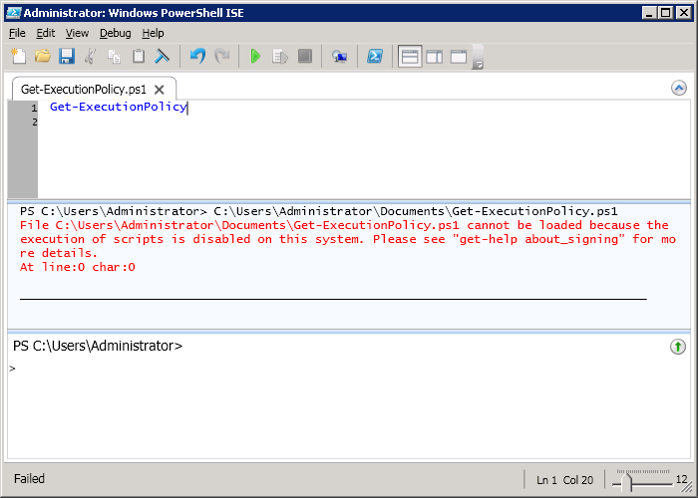
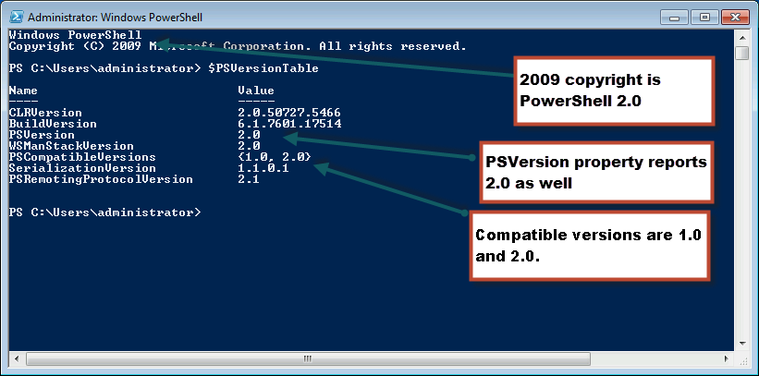
Running PowerShell
2010

Slide 15
Running PowerShell
2010

Slide 16
Running PowerShell
2010

Slide 17
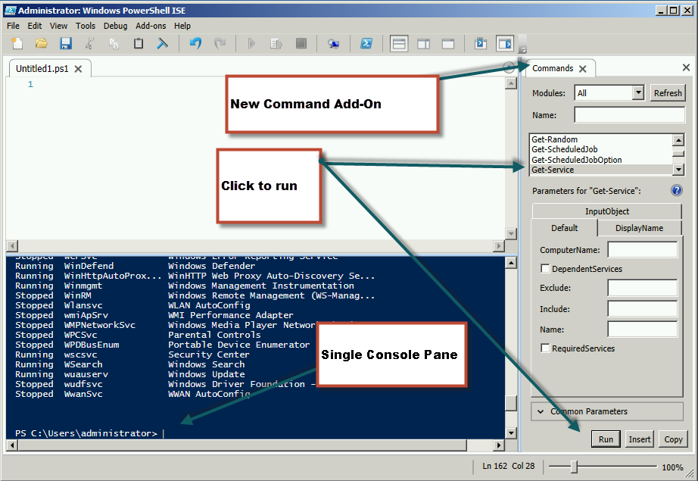
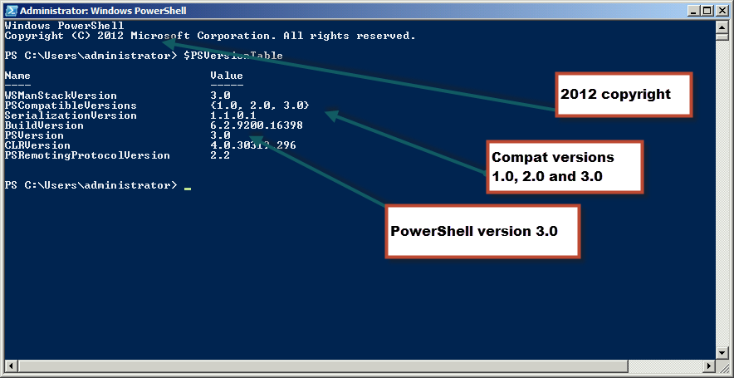
Running PowerShell
2012

Slide 18
Running PowerShell
2012

Slide 19
Running PowerShell
2012

Slide 20
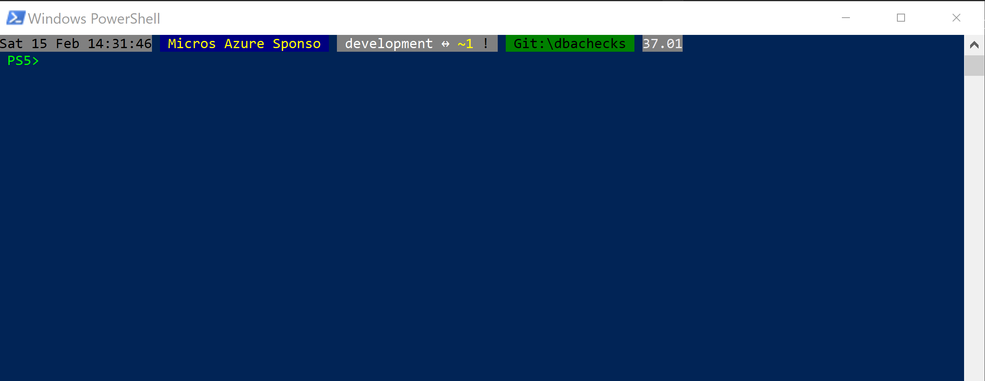
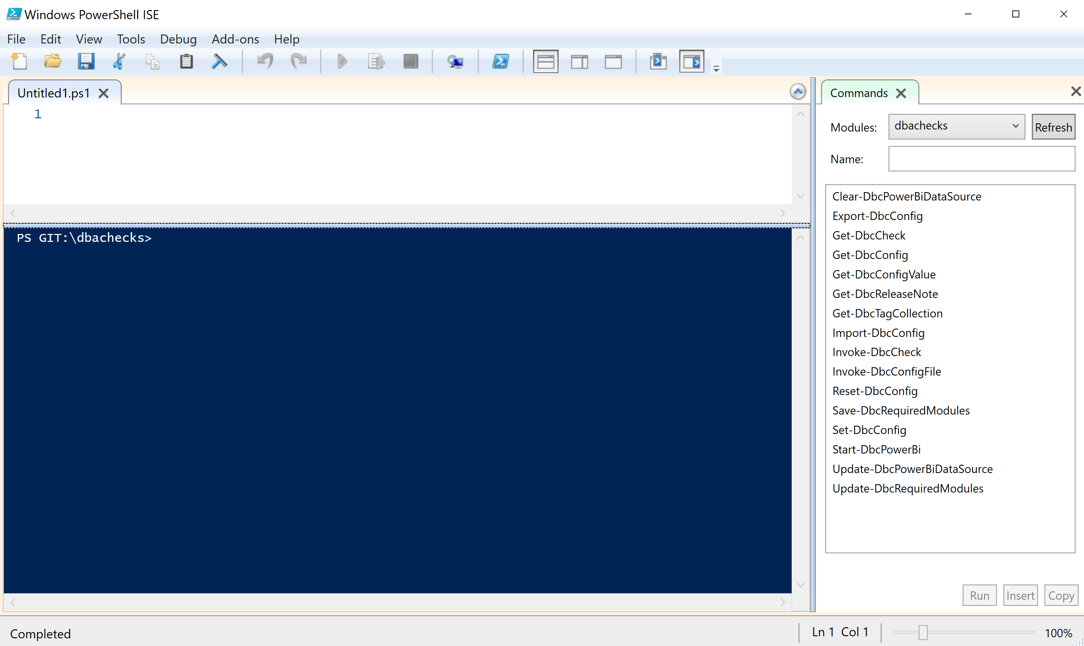
Running PowerShell
2017

Slide 21
Running PowerShell
2017

Slide 22
Running PowerShell
2017

Slide 23
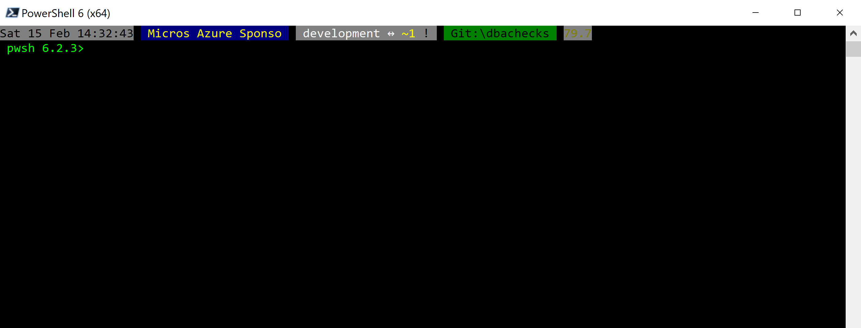
Running PowerShell
2018

Slide 24
Running PowerShell
2018

Slide 25
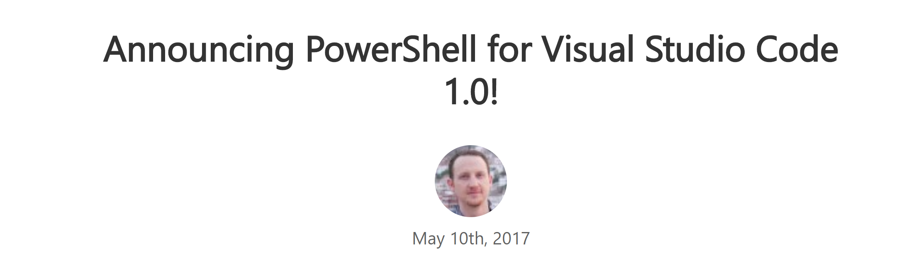
Running PowerShell
2016-17

Slide 26
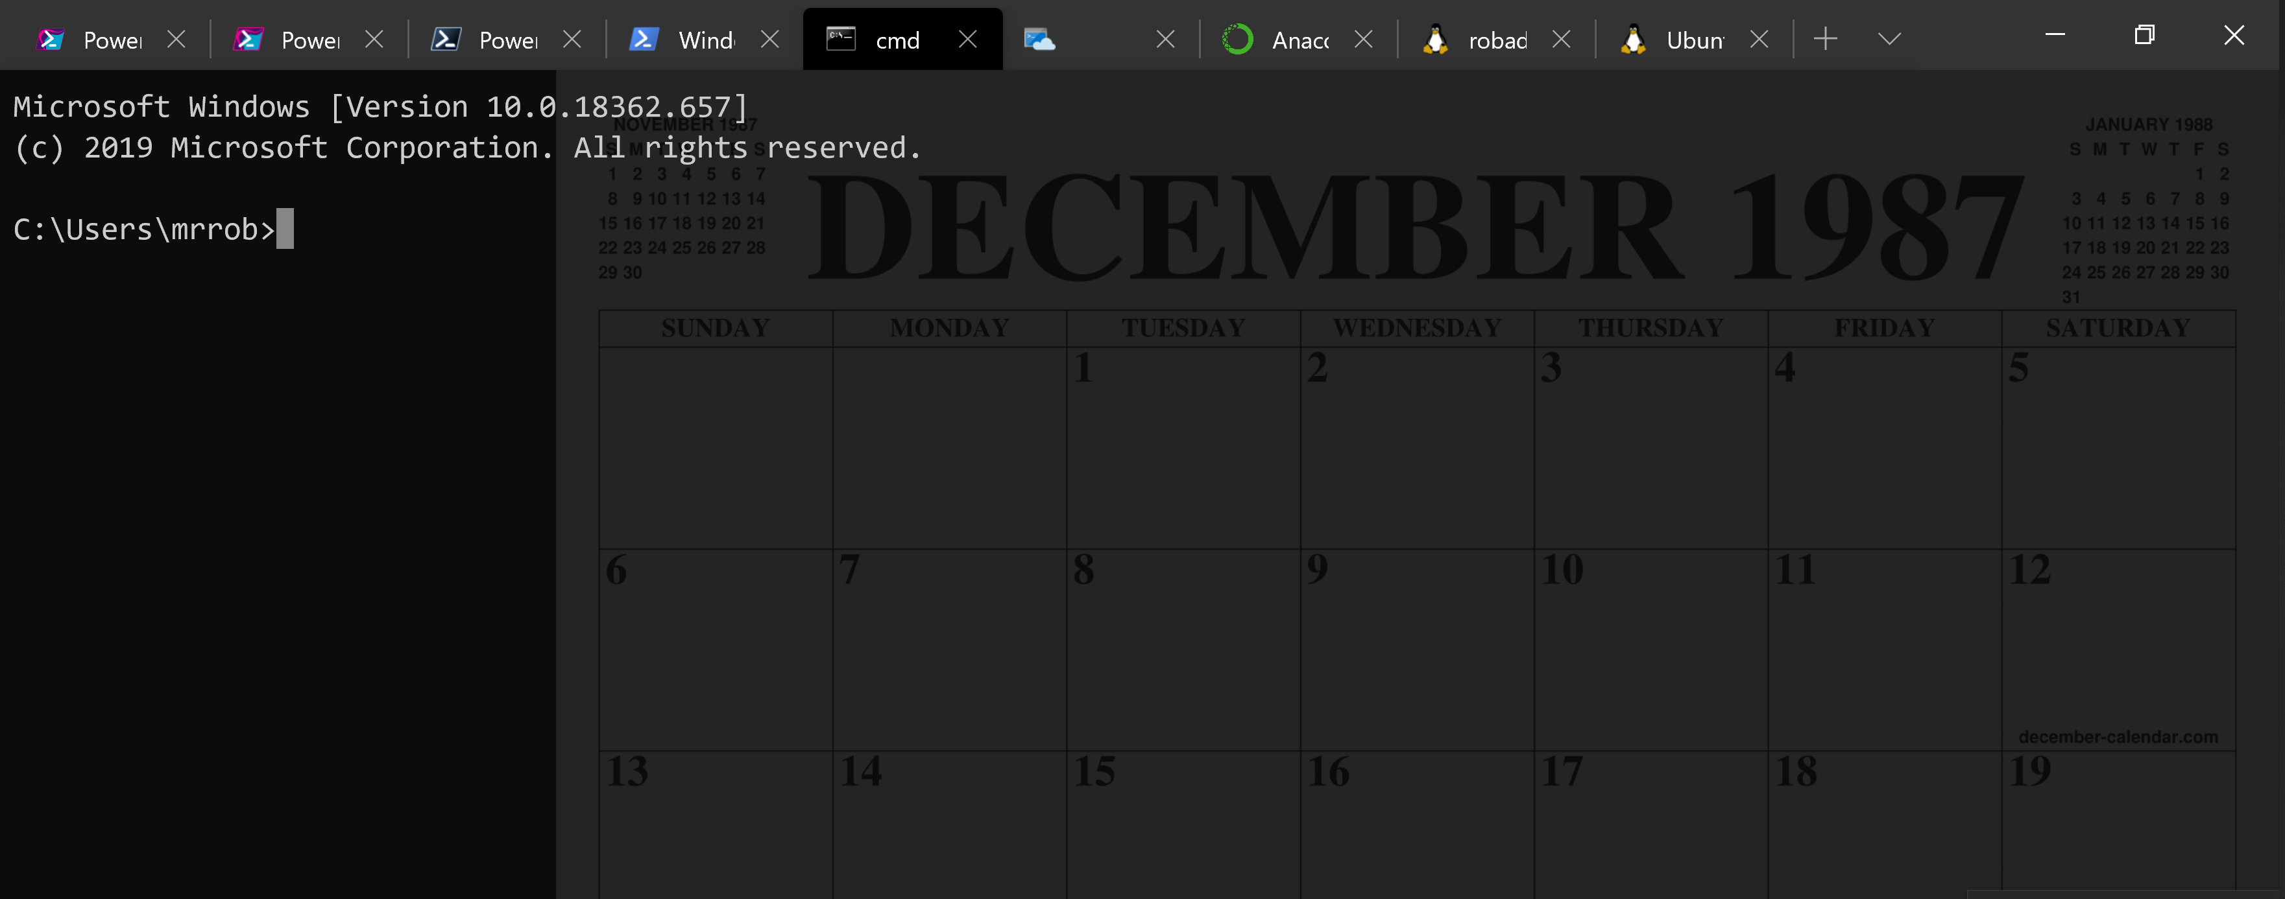
Running PowerShell
2016-17

Slide 27
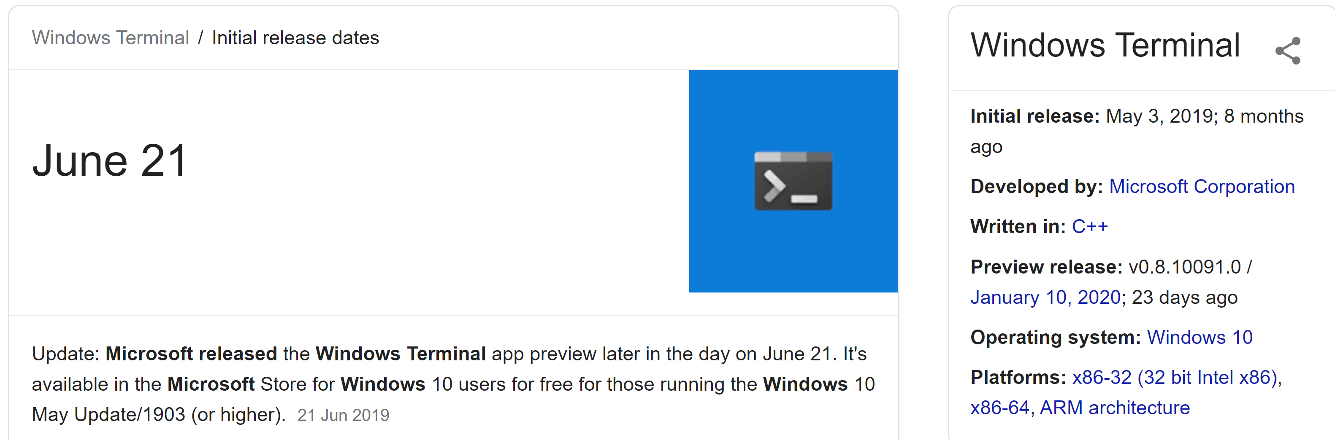
Running PowerShell
2019

Slide 28
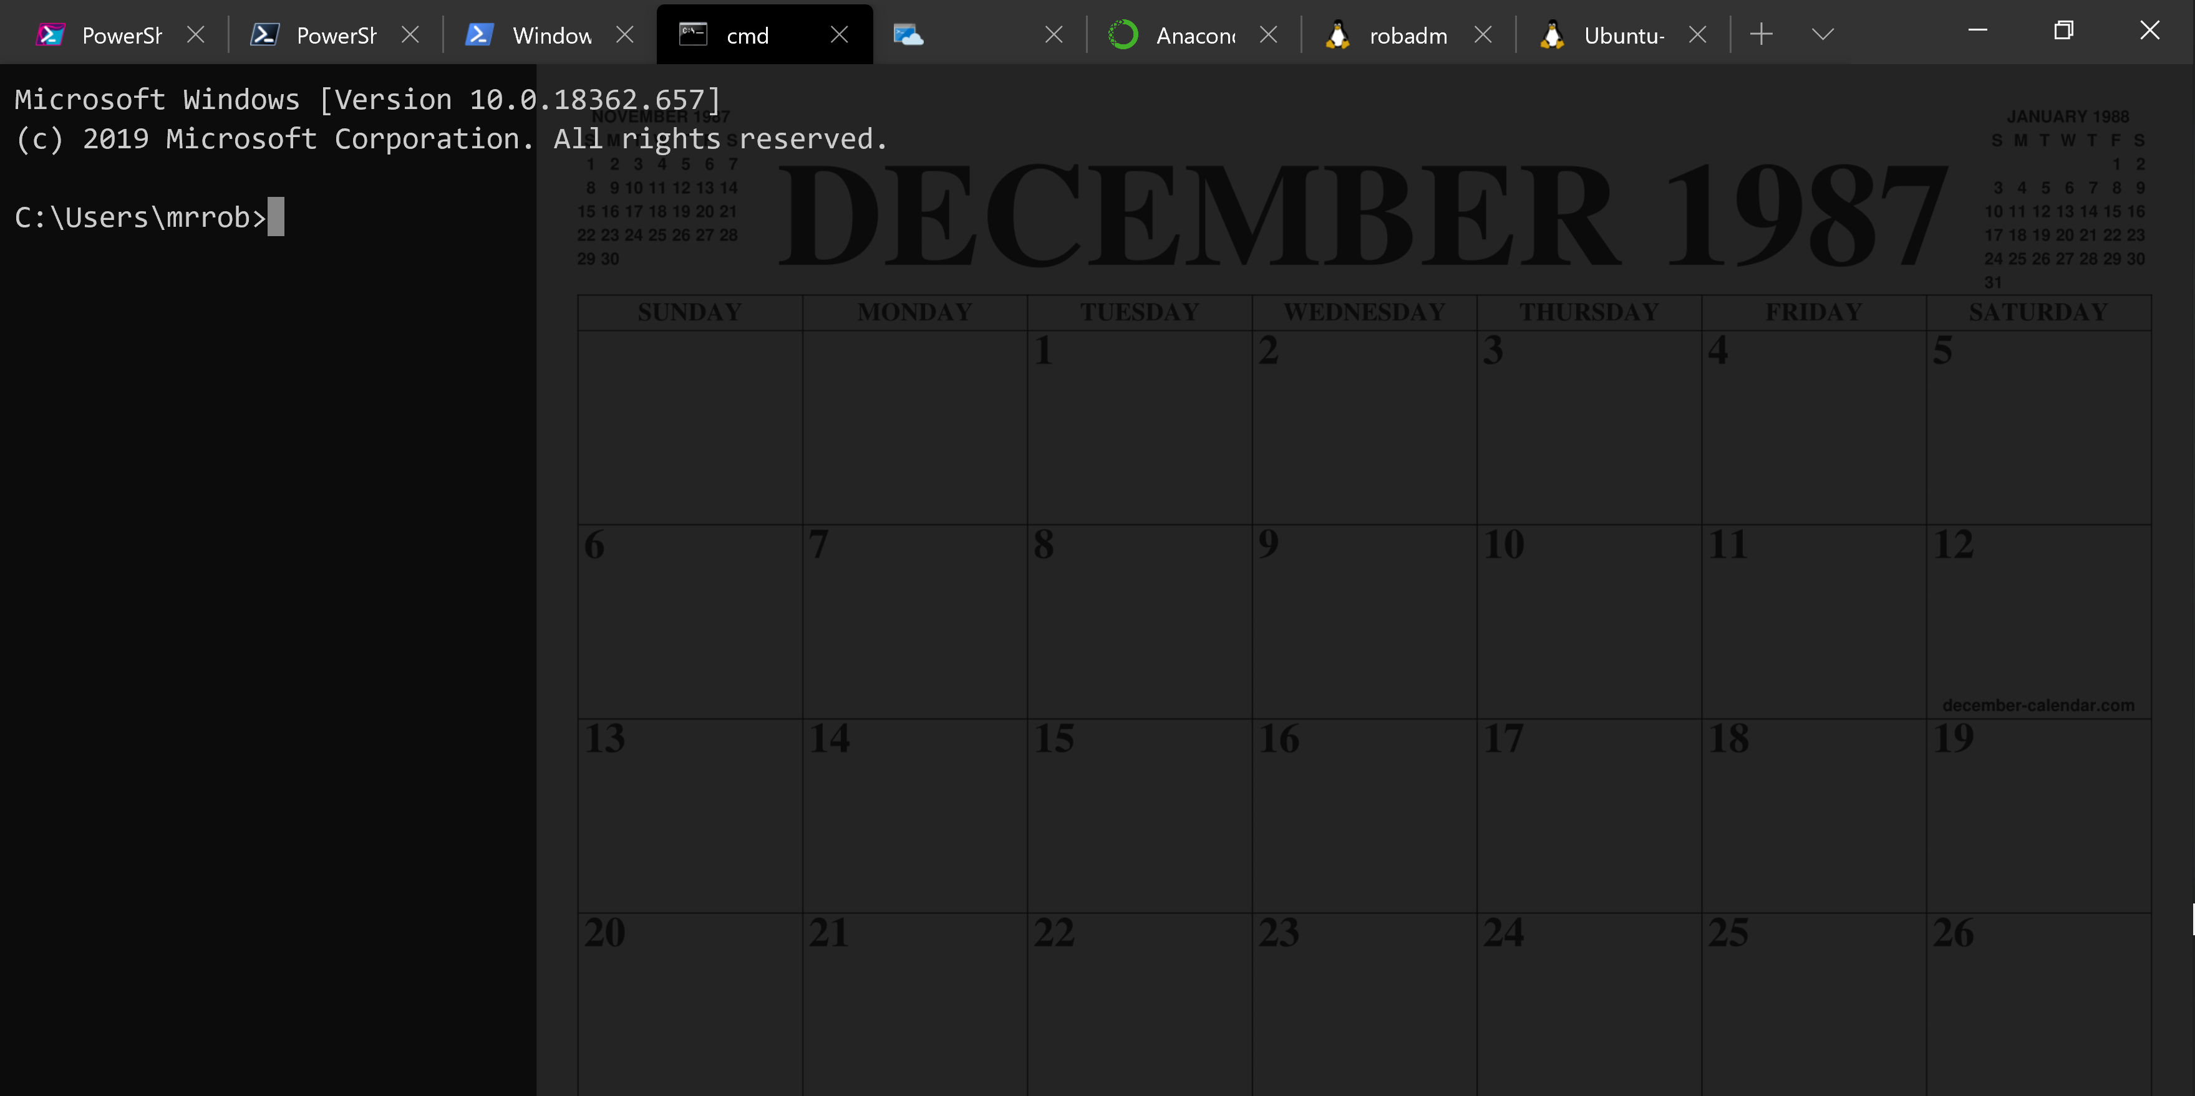
Running PowerShell
2019

Slide 29
Running PowerShell
2019

Slide 30
A Decade and a Half

Slide 31
Uh, Houston, we've had a problem
https://en.wikipedia.org/wiki/Houston,_we_have_a_problem

Slide 32
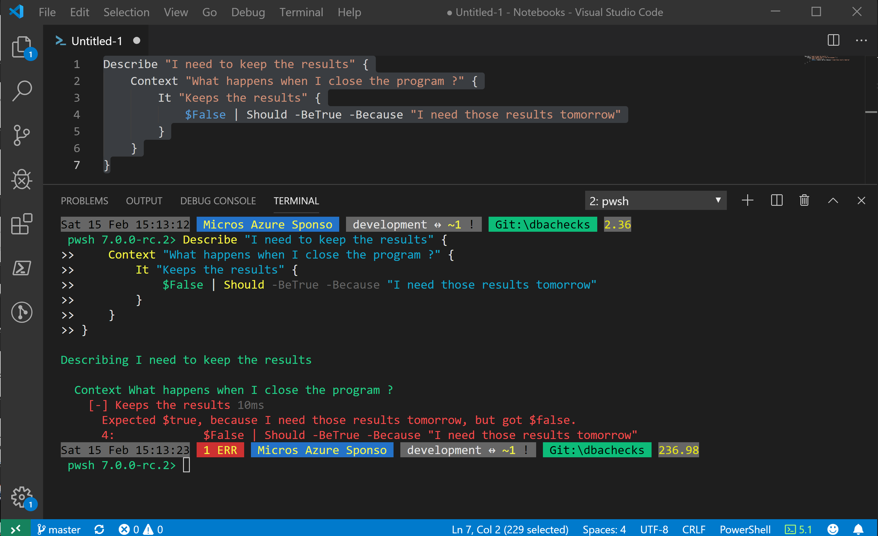
Without some effort………..

Slide 33
Without some effort………..
Notes:
OBS:SpeakerCentreBottom

Slide 34
Without some effort………..
Notes:
OBS:SpeakerCentreBottom

Slide 37
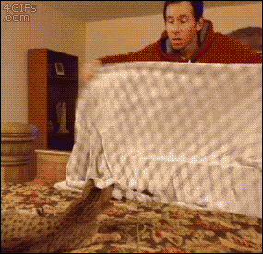

Slide 38


Slide 39
ALL
GONE

Slide 40
What is a Jupyter Notebook?
Document that can contain text, code, images and query results
Notes:
OBS:SpeakerCentreBottom

Slide 41
What is a Jupyter Notebook?
Document that can contain text, code, images and query results
Notes:
OBS:SpeakerCentreBottom

Slide 42
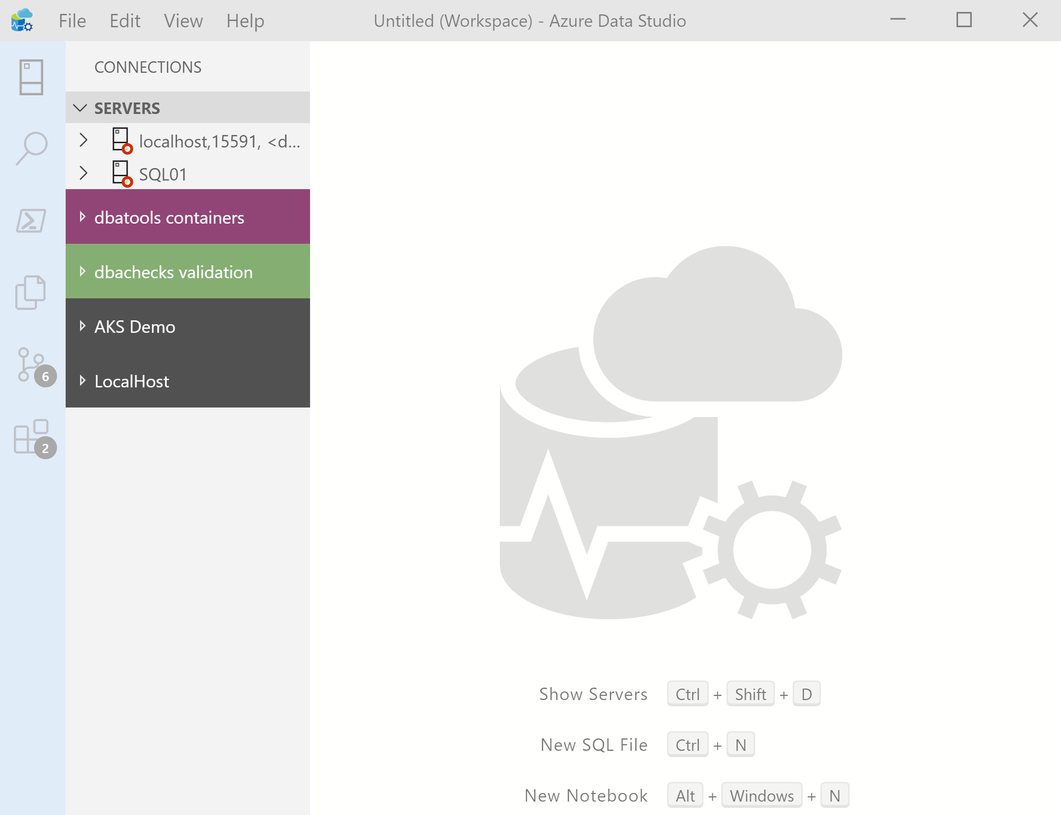
What’s Azure Data Studio ?
Cross Platform desktop environment for Data Professionals
Notes:
OBS:SpeakerCentreSquare

Slide 43
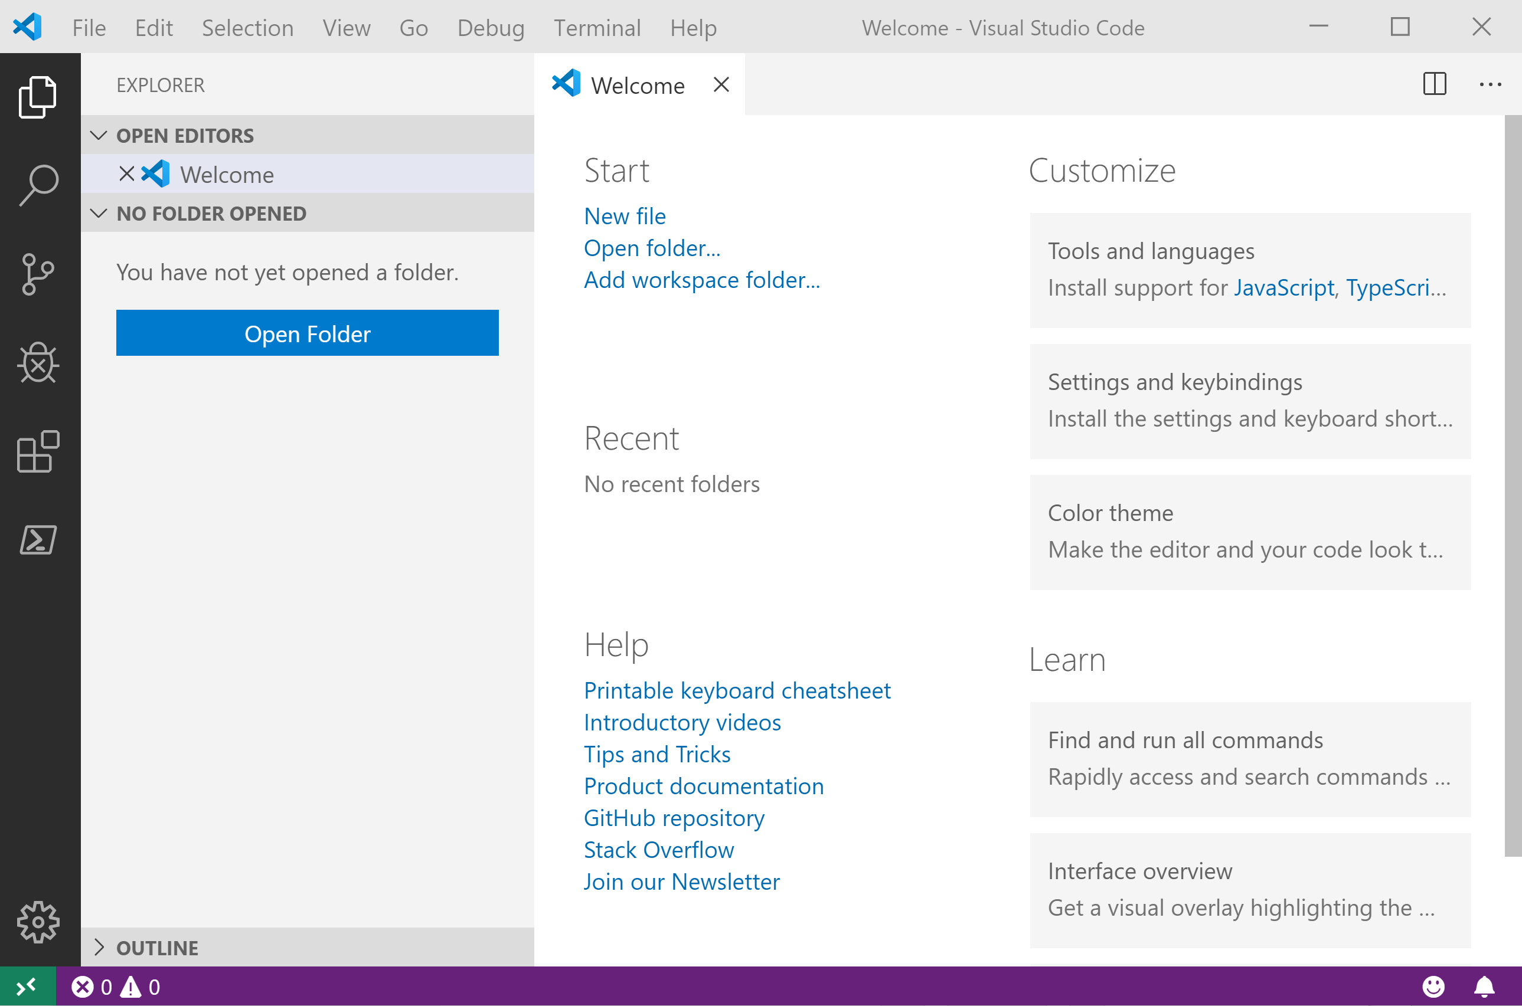
It Looks Like Visual Studio Code ?
Notes:
OBS:SpeakerCentreSquare

Slide 44
It Looks Like Visual Studio Code ?

Slide 45
.NET Interactive Notebooks
Announced at Ignite but preview announced with PowerShell February 6th 2020 https://devblogs.microsoft.com/dotnet/net-interactive-is-here-net-notebooks-preview-2/
@SQLDBAWithBeard SqlDbaWithABeard.com Rob Sewell beard.media/book

Slide 46
.NET Interactive Notebooks
All the goodness of Jupyter Notebooks with added
PowerShell (and C#) (and F#)
@SQLDBAWithBeard SqlDbaWithABeard.com Rob Sewell beard.media/book

Slide 47
Notebook Mode in the PowerShell Preview extension for Visual Studio Code
https://devblogs.microsoft.com/powershell/public-preview-of-notebook-mode-in-the-powershell-preview-extension-for-visual-studio-code/
@SQLDBAWithBeard SqlDbaWithABeard.com Rob Sewell beard.media/book

Slide 48
Whatcha gonna do?
Incident Response
Run Books – Common Tasks
Training/ New Starter Introduction
Demos – Clients/team members/boss/ presentations/open source

Slide 49
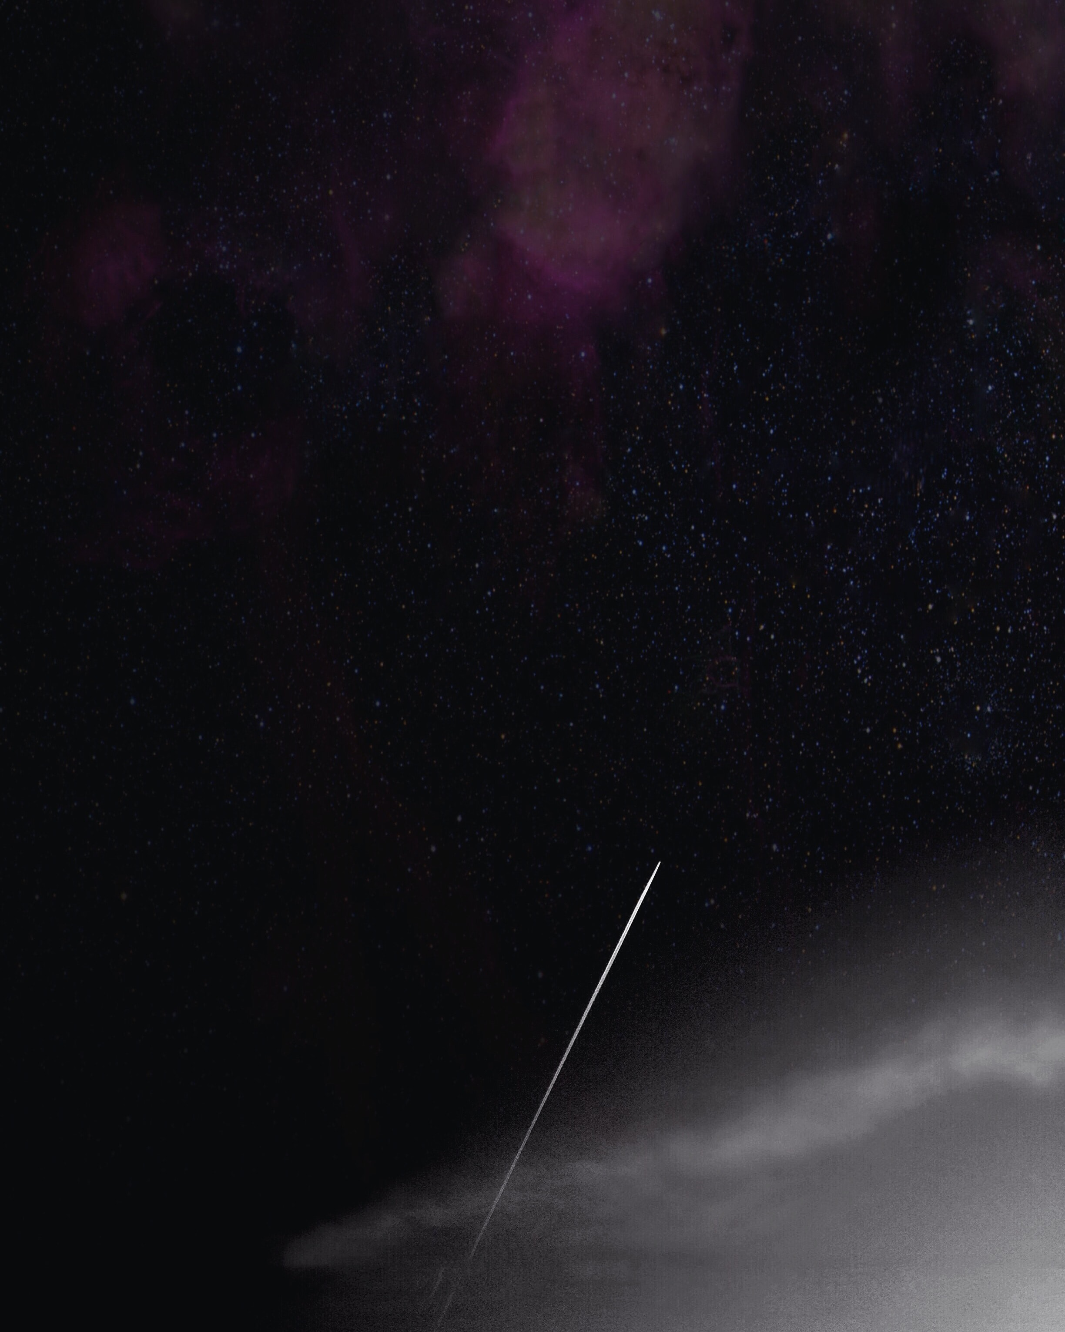
Photo by naomi tamar on Unsplash

Slide 50







Incident Response Flow & Ecosystem
From Julie @MSSQLGirl https://github.com/MsSQLGirl/jubilant-data-wizards
System Event / User Reported Incident
Use existing notebooks
Create new notebooks
Add reusable notebook
Rate existing notebooks
Log adhoc notebook in incident system
Update notebook if necessary
Automate
Incident Response System
Investigate & Mitigate
Use Notebook as the incident’s audit trail
Post Mortem
Analyze and enrich Troubleshooting Repo
Troubleshooting Notebook Repo
Notes:
JULIE

Slide 51
Enough talk
Lets see it!
beard.media\book
@sqldbawithbeard
SQLDBAWithABeard.com
@SQLDBAWithBeard SqlDbaWithABeard.com Rob Sewell beard.media/book

Slide 52
Wondering how I did this?
Bit of PowerShell
PowerPoint
And StreamLabs Obs
https://beard.media/slobsautomation
Notes:
OBS:SpeakerTopRight

